Slide 1

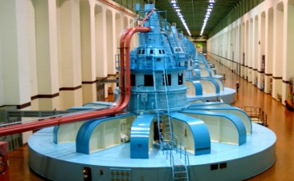

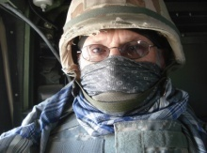
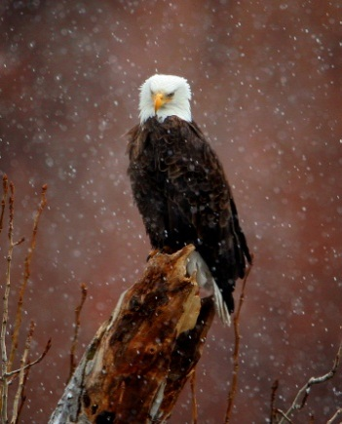
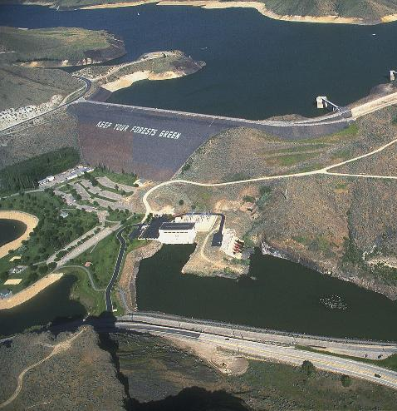
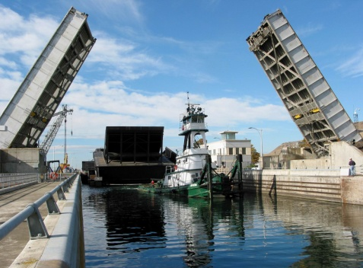

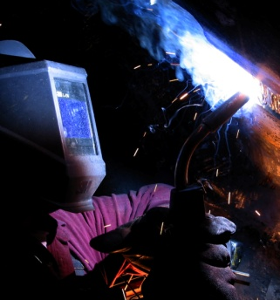
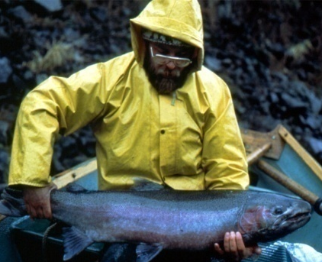
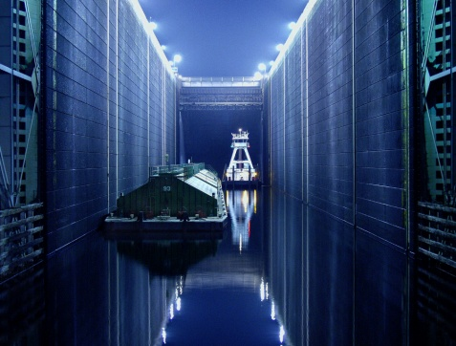
AVIAN ABUNDANCE AND DETERRENT MEASURES AT NWW & NWP DAMS
FPOM – Subgroup:
Inland Avian WG – Dam Component
September 12, 2013
Portland, OR
US Army Corps of Engineers
BUILDING STRONG®

Slide 2
2013 Avian Update
Trends at USACE Dams April – present
Trends at specific dams in April - present
Deterrent plans for 2014

Slide 3
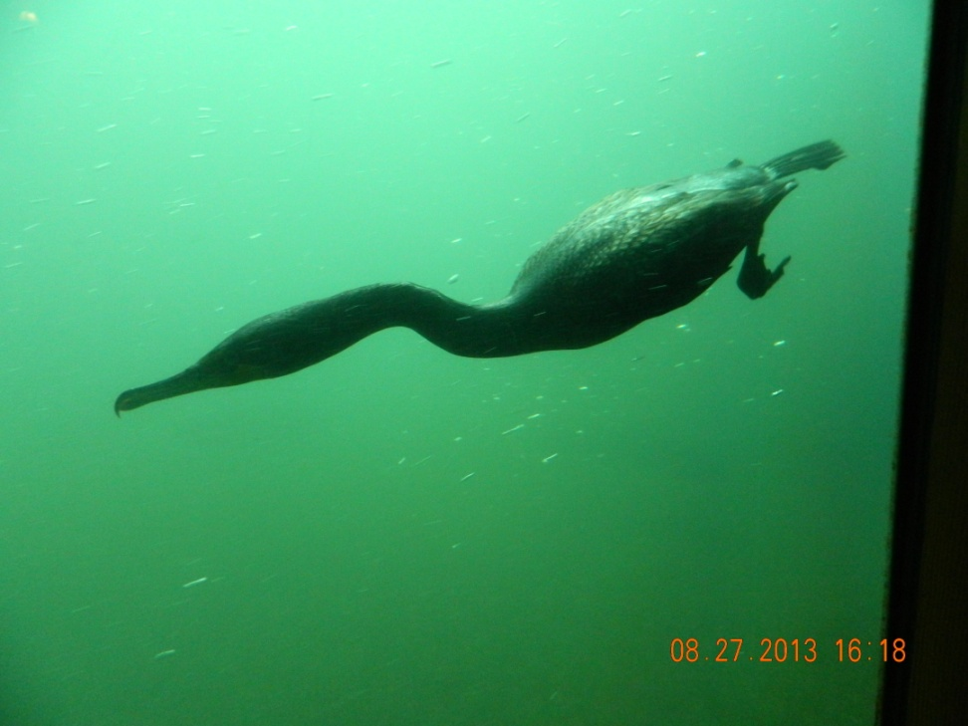
Data Reporting – calculated means
Provide broader trends
Reduce our ability to detect individual behavior
Time scale may soften resolution
  Daily, Weekly, Seasonally
Photo by James Browne Bonn Volunteer
Notes:
Time frame matters. Here we report daily & seasonal means.

Slide 4
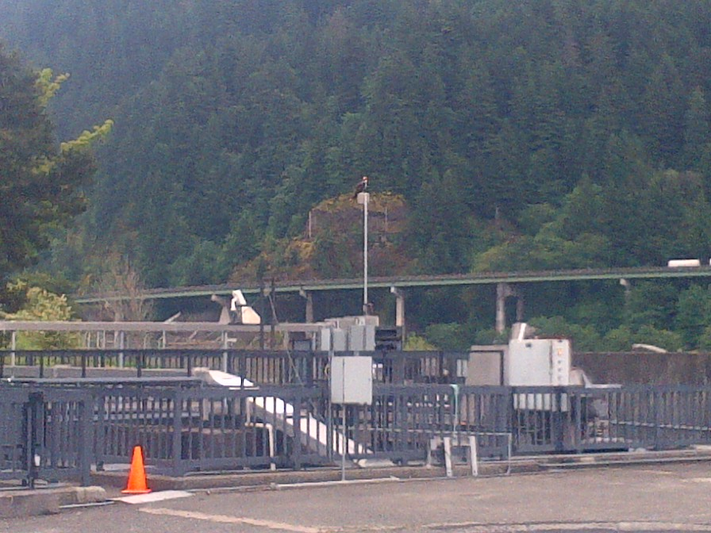
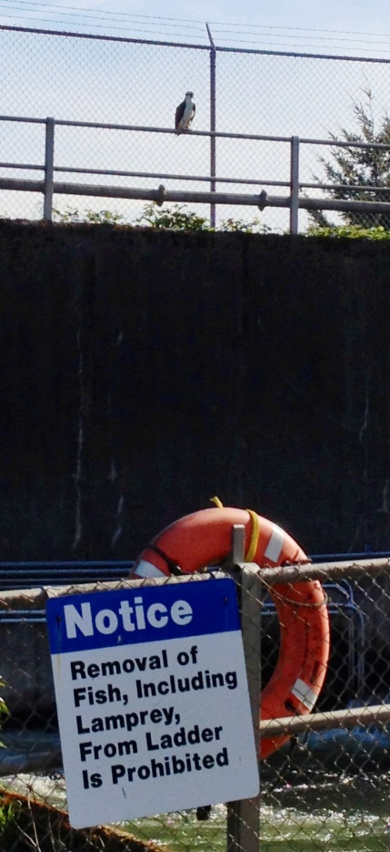
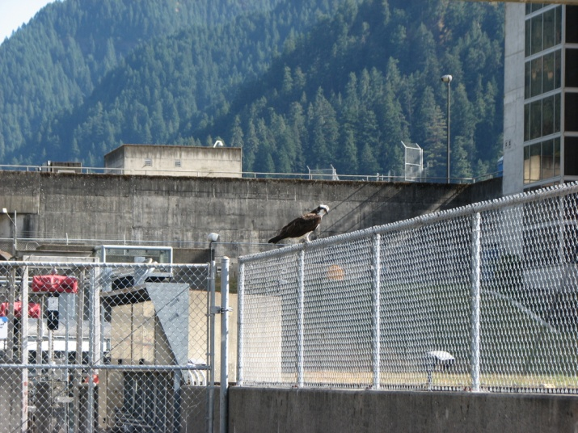
Osprey are common at Bonn, not well represented by seasonal means. Graphically they are swamped out by other birds.
Photo by Brian Bissell
Notes:
OSPR are most abundant at Bonn, nest above PH1

Slide 5
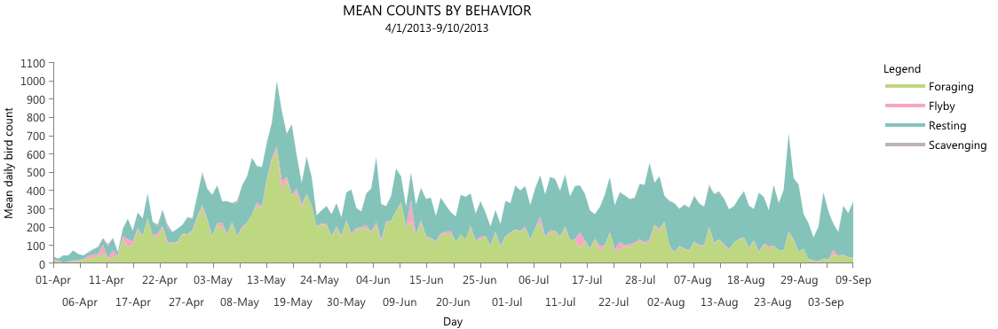
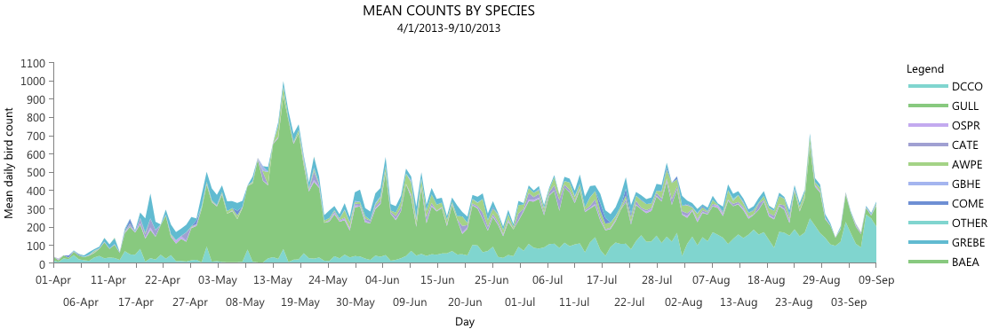
GULL
DCCO
Notes:
Season’s Trends – stacked lines by behavior & species

Slide 6
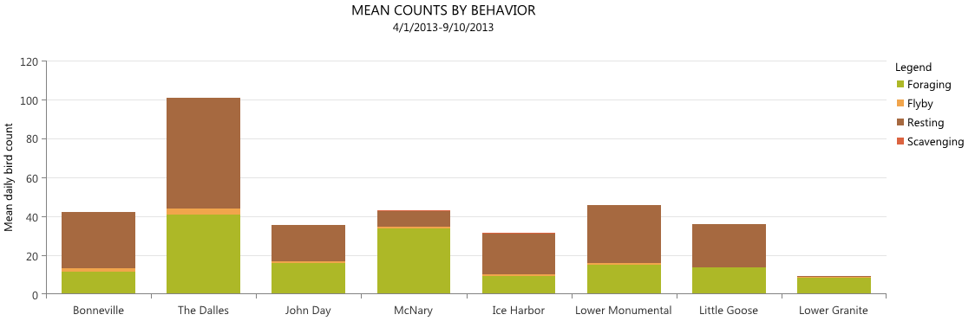
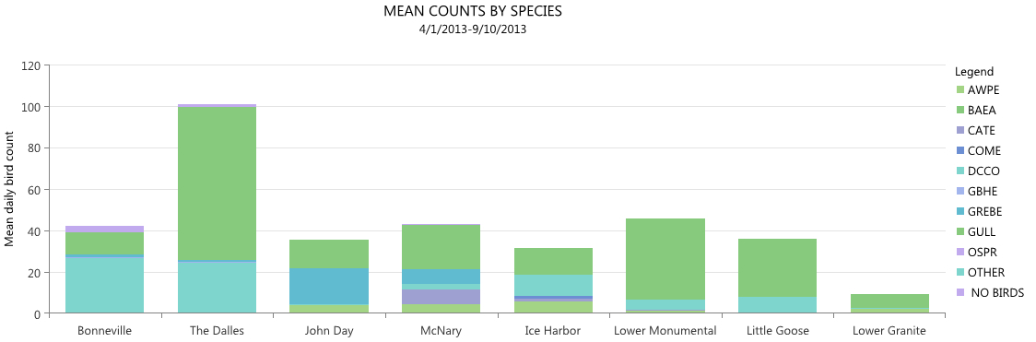
GULL
DCCO
GREBE
CATE

Slide 7
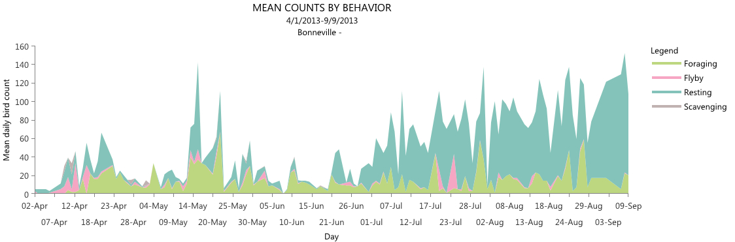
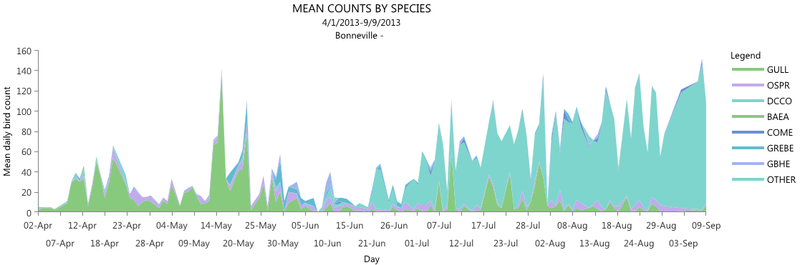

Slide 8
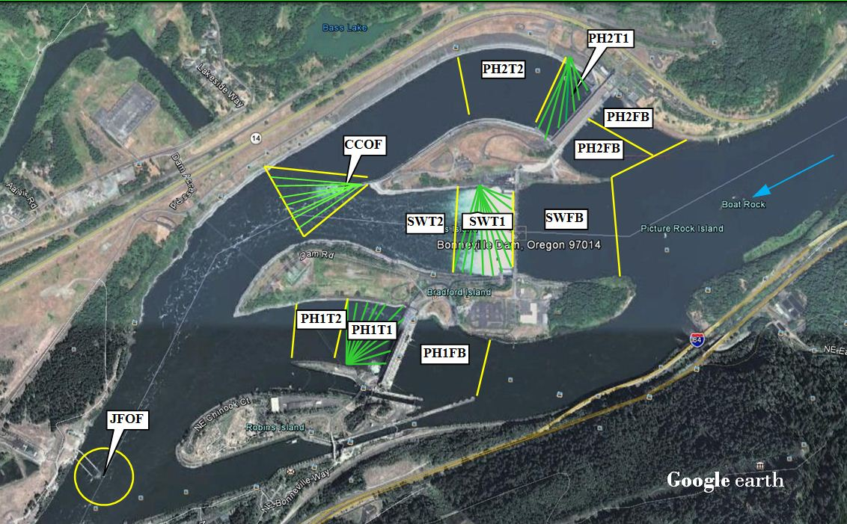
Bonneville Dam 2014
Perch deterrents on several hand rails (PH Tailrace)
2 Hydro cannons on JFOF
Notes:
Work Plan includes USDA re-installing wires to PH2T1 & CCOF NLT 4/9.

Slide 9
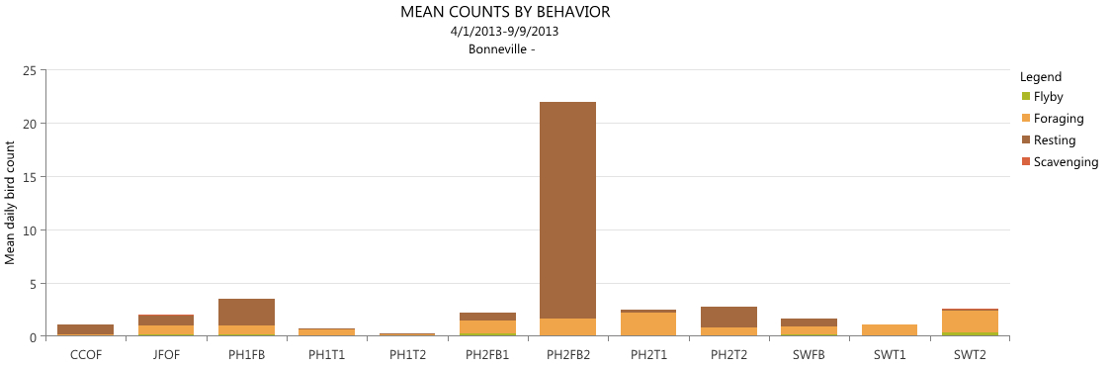
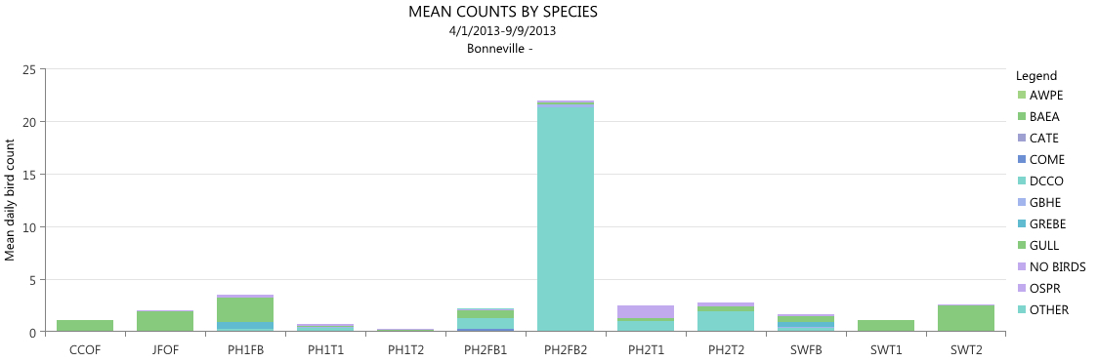
Notes:
DCCO resting in PH2FB2 dominate this time period, GULLS did earlier April & May

Slide 10
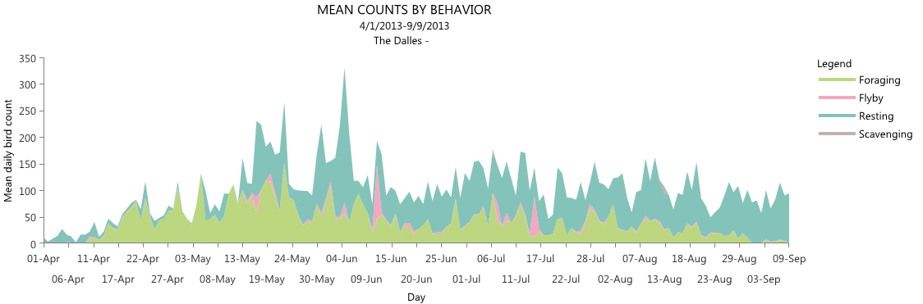
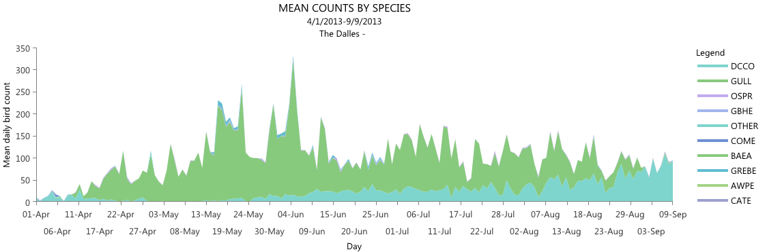
Notes:
Resting increases over time, as do DCCO

Slide 11
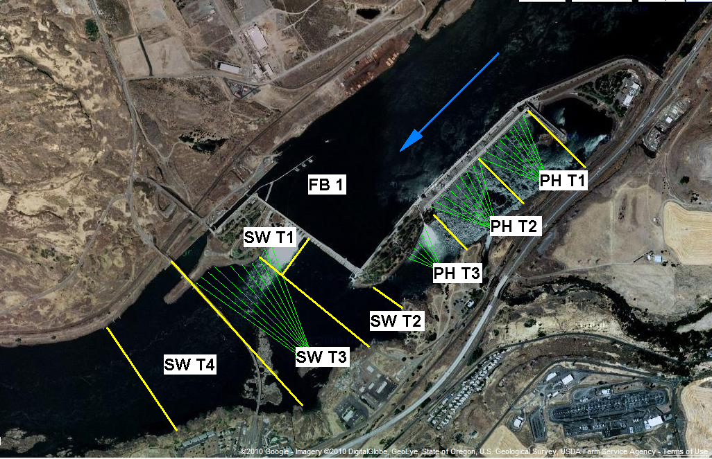
The Dalles Dam 2014
SW T5
Notes:
No new wire work planned

Slide 12
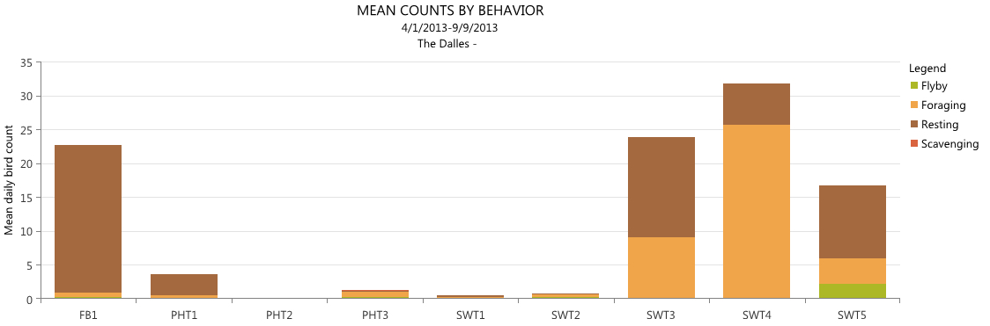
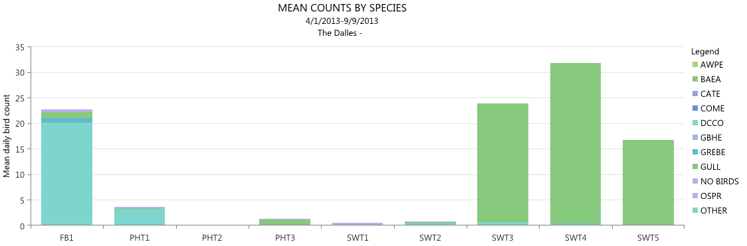
Notes:
DCCO resting in the electrical transmition towers – FB1
GULL resting on rock island in SW T3 & T4

Slide 13
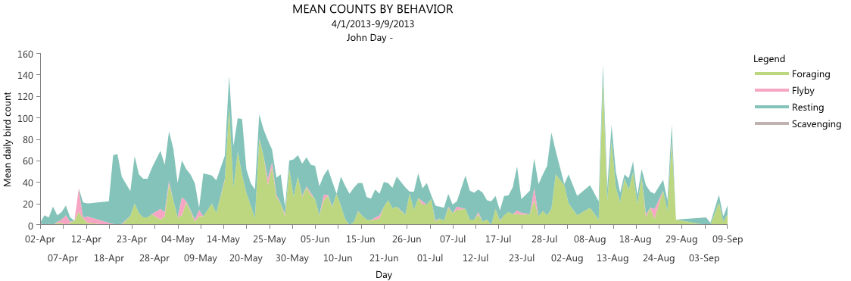
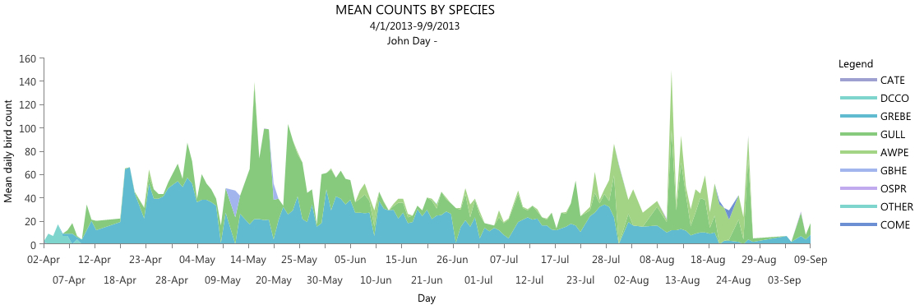

Slide 14
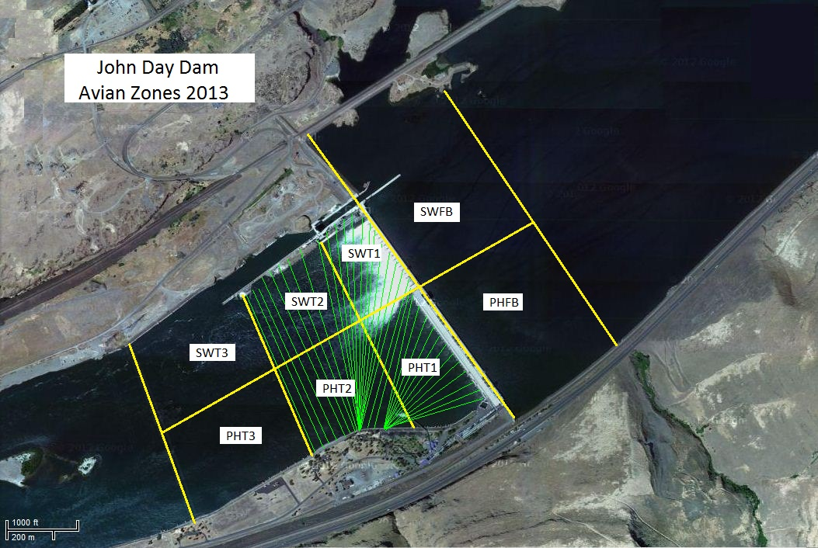
John Day Dam 2014
Notes:
No new wire work planned for 2014

Slide 15
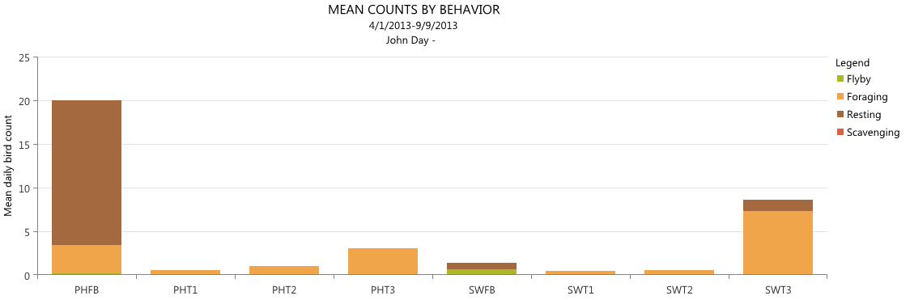
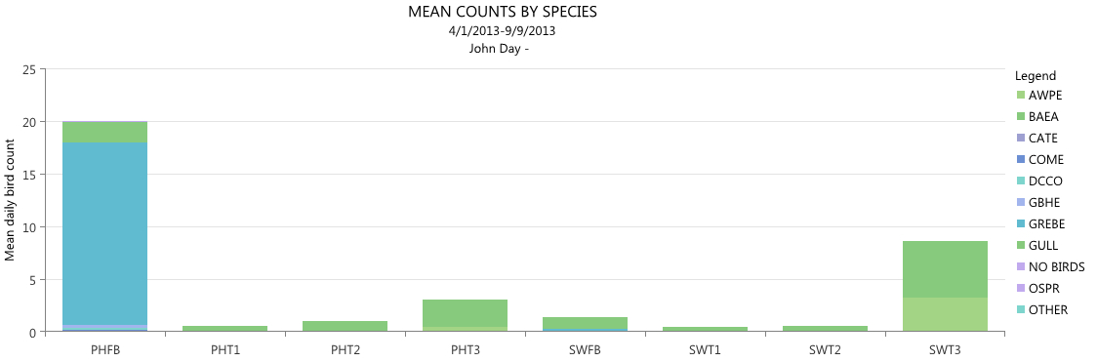
Notes:
GREBEs resting in the PHFB
GULLS & AWPE Foraging in the tailrace zones

Slide 16
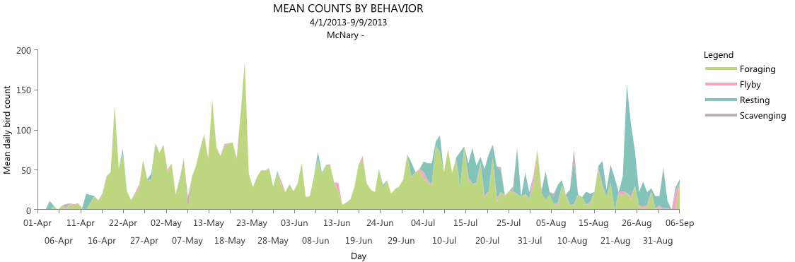
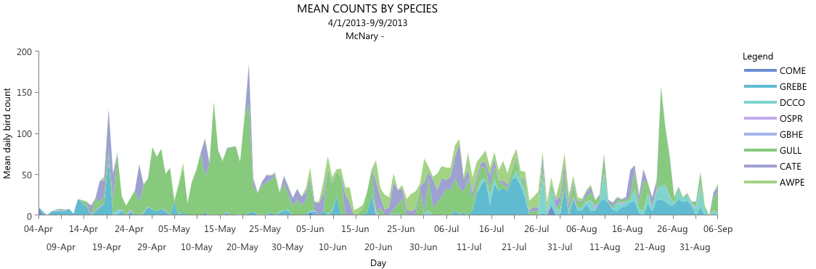
Notes:
Lot of diversity here, close to five large waterbird colonies
Green = Gulls, blue = GREBE , purple = CATE

Slide 17
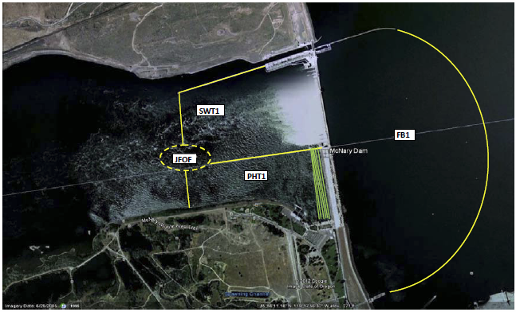
McNary Dam 2014
Perching deterrents: wires strung over barge dock hand rail and outfall pipe.
JFOF hydro cannon – permanent pump and piping to be installed this fall.
Propane cannons: 2 end nav lock wing wall, 1 at the west end of the navlock, 1 at the end of the north ice-trash sluiceway, and one about 3/4 out on the outfall pipe.
13 overhead wires total.
Notes:
Expanded pyro hazing dates to include boat based 3 days / week

Slide 18
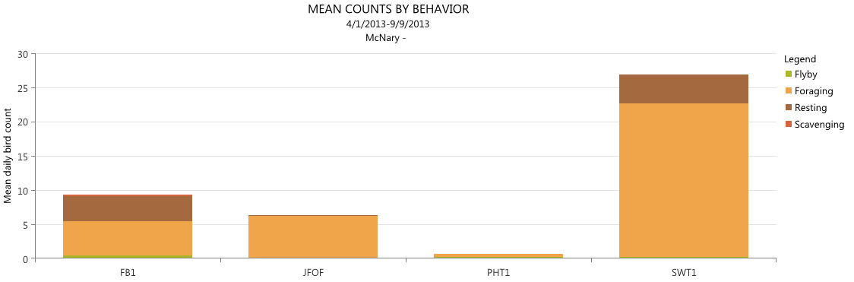
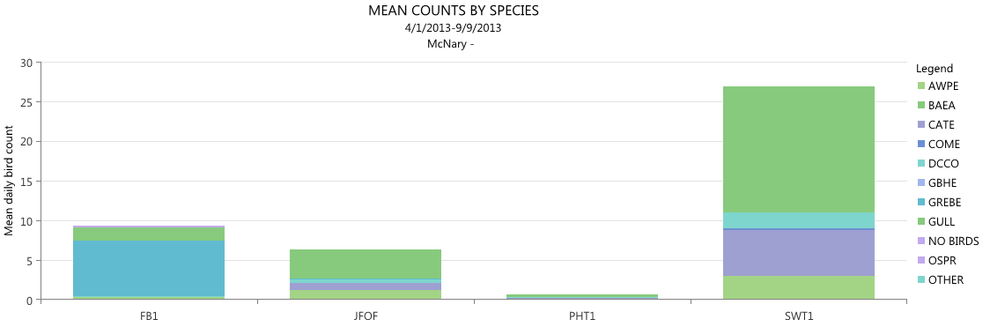
Notes:
GREBEs in FB1
GULL, CATE, AWPE, and DCCO in SWT1

Slide 19
GULL
DCCO
GREBE
CATE
Notes:
We are now heading up the Snake River.
Here’s a reminder of how the dams compare over the season

Slide 20
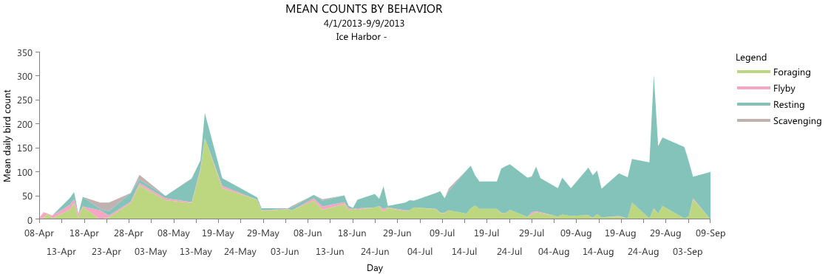
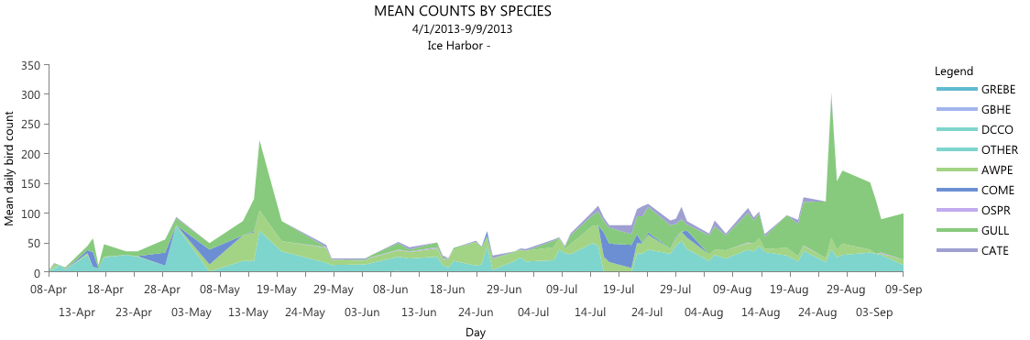

Slide 21
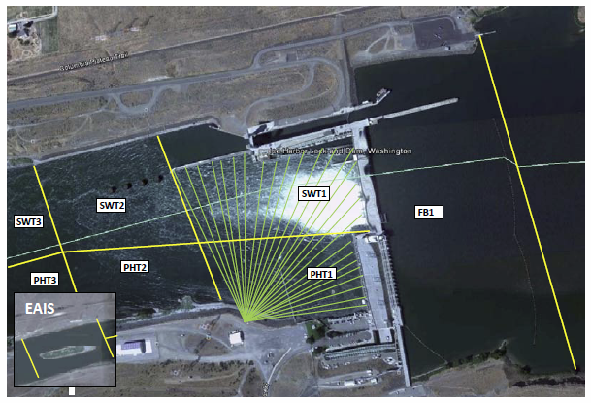
Ice Harbor Dam 2014
Perching deterrents: wire over nav. lock wing wall hand rail and spider wire on wing wall light poles and forebay buoys.
Hydro cannon at end of fish bypass outfall pipe.

Slide 22
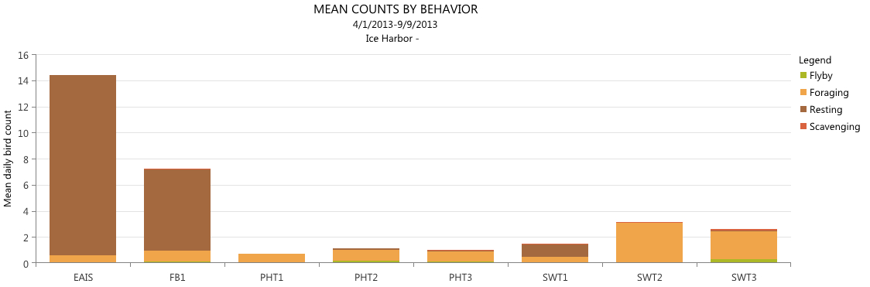
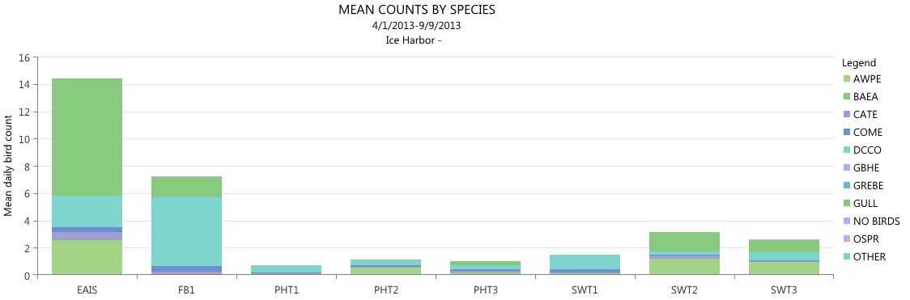
Notes:
EAIS – GULLs, DCCOs, AWPEs
FB1 - DCCO

Slide 23
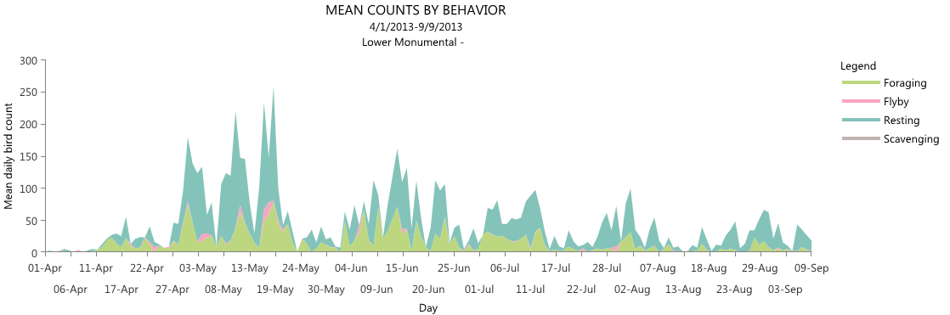
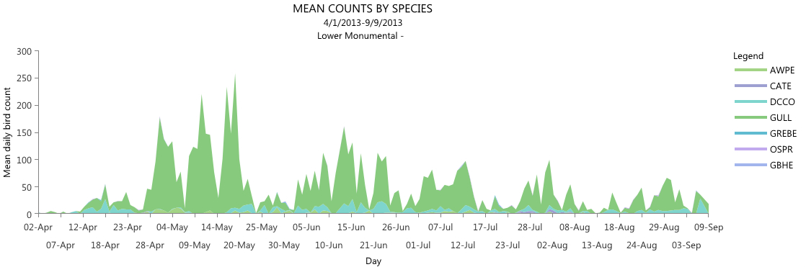
Notes:
Dominated by GULLS, DCCO in blue, AWPE in light green

Slide 24
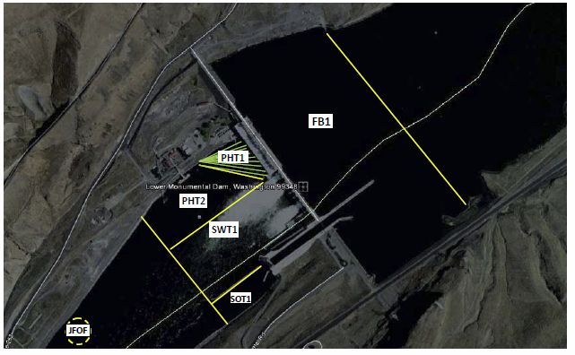
Lower Monumental Dam 2014
Hydro cannons at end of fish bypass outfall pipe.
Perching deterrents: wire over nav lock wing wall hand rail, spikes installed on downstream end of wing wall deck.

Slide 25
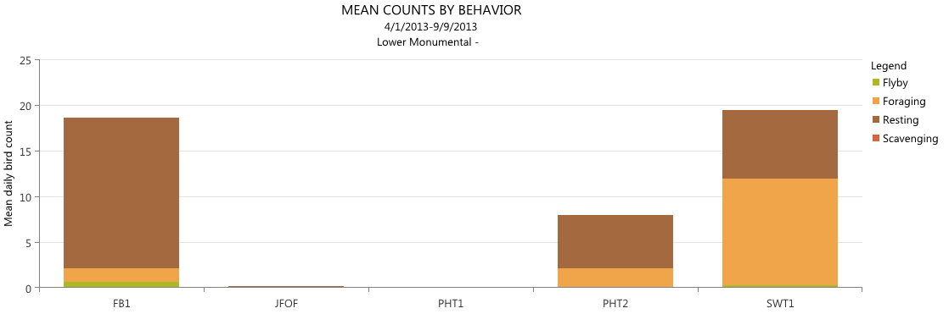
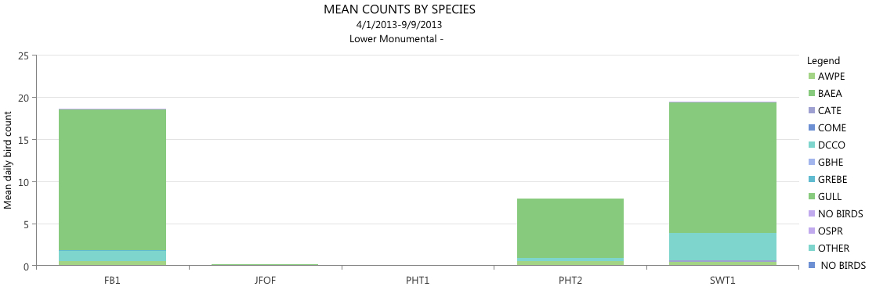
Notes:
GULLS in green, DCCO in blue

Slide 26
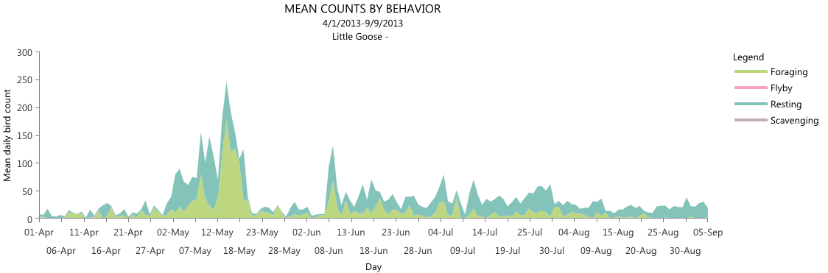
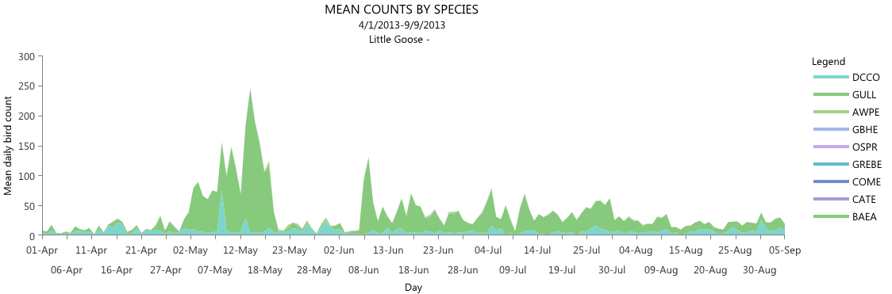
Notes:
GULLs and a few DCCO

Slide 27
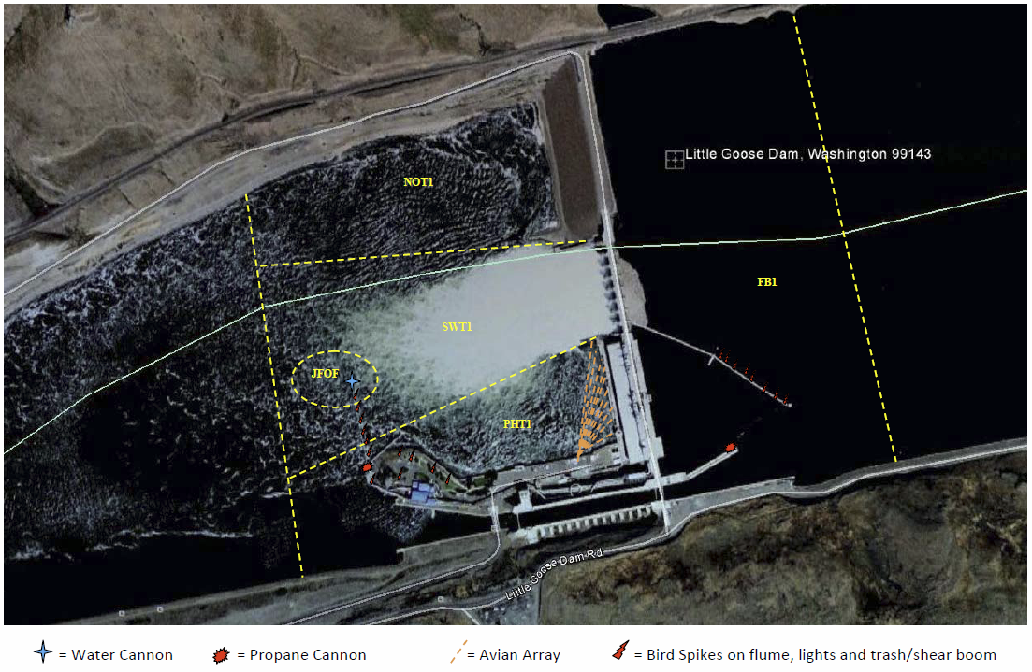
Little Goose Dam 2014

Slide 28
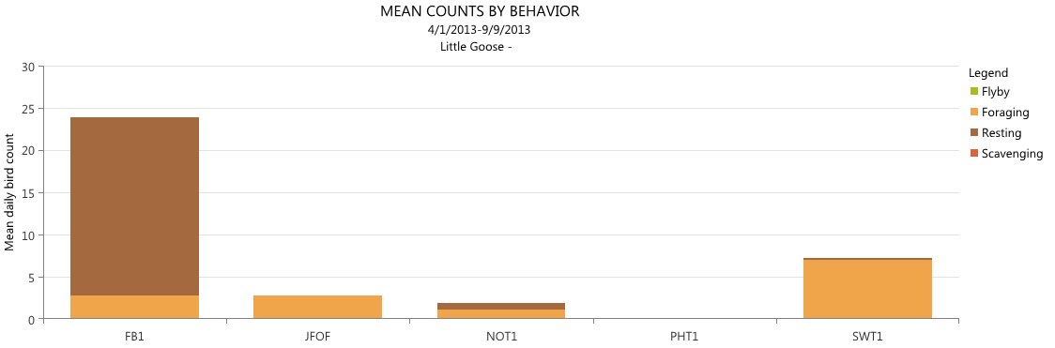


Slide 29


AWEP
GULL

Slide 30

Lower Granite Dam 2014
Perching deterrents: wires above nav lock wing wall hand rails, row of spike wire on guide wall deck, and spider wires on top of guide wall light poles and forebay buoys.

Slide 31


GULL
AWEP

Slide 32
2014 Planned Avian Deterrents
Dam | Perch deter-rents | Bird Wires |  | Hazing measures |  |  |  |  |  |  | Hazing effort
 |  | Tailrace |  | Hydro-cannon | Boat-based | Lethal take | Propane cannon | Distress call | Pyro | Other | Dates | Amount
 |  | PH | SW
Bonneville | X | X | X | X |  |  |  |  | X |  | 4/1 - 7/31 | 8 hrs all days
The Dalles |  | X | X |  |  |  |  |  | X |  | 4/16 - 7/31 | 14 hrs all days
John Day |  | X | X |  | X |  |  |  | X |  | 4/16 -7/31 | 8 hrs all days
McNary | X | X |  | X | X | X | X |  | X |  | 3/30 – 8/2 | 4/20 – 7/12: 16; rest of time: 8 Boat 3 days/wk
Ice Harbor | X | X | X | X | X | X | X | X | X | Laser | 4/1 - 6/30 | 16 hrs
Lower Monumental | X | X |  | X |  |  |  |  | X |  | 4/1 - 6/2 | 5/6 - 6/2: 16; rest of time: 8
Little Goose | X | X |  | X |  | X | X |  | X |  | 4/1 - 6/16 | Five days per week: 8+
Lower Granite | X | X | X |  |  | X | X |  | X |  | 4/1 - 6/30 | 4/21 – 6/1: 16; rest of time: 8
“X” indicates action occurs
Notes:
“X” indicates action occurs
Bird hazing techniques will include the use of 15mm pyrotechnics and Dominator Rocket pyrotechnics. 15 mm pyrotechnics will be launched from a .22 cal starter pistol firing blanks. Rockets will be launched from a WS approved launching mechanism.

Slide 33


Bonneville JFOF
2008 & 2012
Photo from Richard Weis
Photo from Richard Weis
Notes:
Fish trucked from LGR, LGO, and LoMo face predation at Bonn JFOF.
Hazing contract expires the end of July. NAZO counting this season but drivers have years of counts.

Slide 34


Funding into FY14
The data portal has been paid for by CRFM through FY13, but will not be starting in FY14.
If the fish managers want to have bird data continued to be reported in-season need to identify this for O&M consideration.
~$30k for all 8 dams and 5 tablet PC’s for data collection & uploading.

Slide 35
Surprises from Winter 2012

Slide 36


Ring billed gulls
John Day Winter 2012
Photos by Dale Klindt
Notes:
Several days with counts over 1,000
Importance of near dam areas for over wintering birds
Usually ignored because few if any ESA fish present

Slide 37

Common Mergansers
The Dalles Winter 2012
Notes:
Winter observations are teaching us more about piscivorous bird dynamics at the dams.
Play video clip if time allows.

Slide 38


Ice Harbor
December 2012
Photos likely from ICE Project staff Mark Plummer?

Slide 39


Bonneville
Notes:
We’ve learn from the estuary the species interaction can drastically change abundance – BAEA chases GULLs
GULLs are a constant presence, even in the winter, though the species might change

Slide 40

Thanks to the Project biologist,
Assistant Biologist, and Biological Technicians that collected the data and many photos presented here!
Notes:
Bird monitoring - A task that has become more involved & time consuming – is yielding great results.

